Slide 1


Config Generator User guide
May 2019

Slide 2
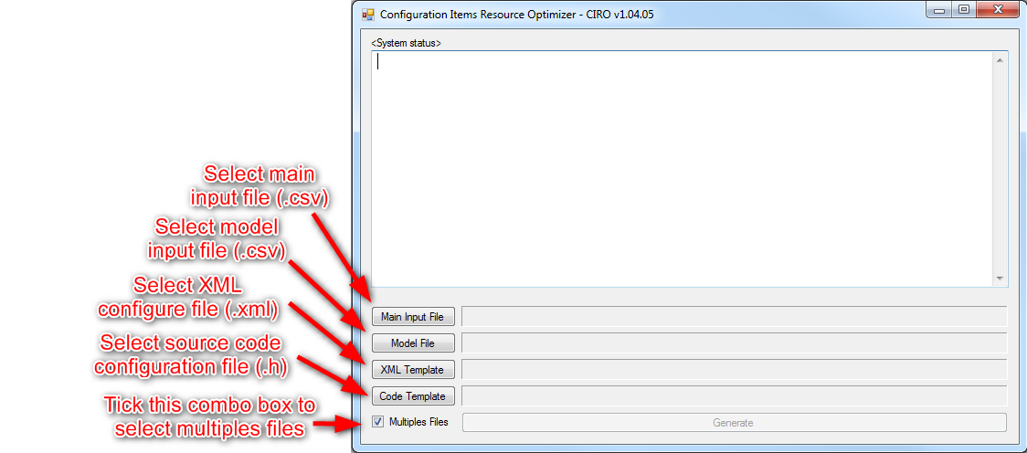



How to use tool
USA
www.datalogic.com
Copyright Datalogic 2017 – Confidential & Proprietary Information

Slide 3
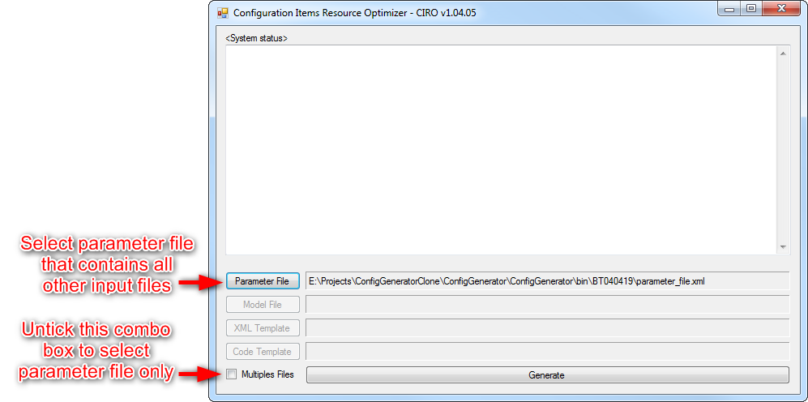
How to use tool
USA
www.datalogic.com
Copyright Datalogic 2017 – Confidential & Proprietary Information

Slide 4
How to use tool
Tool will shutdown by itself after all files are generated
Tool will stop and allow developer to rerun again with same files (after modification) if there is any issue found.
All issues will be log in to “product_name”.csv file
Issue could be warning or error.
USA
www.datalogic.com
Copyright Datalogic 2017 – Confidential & Proprietary Information

Slide 5
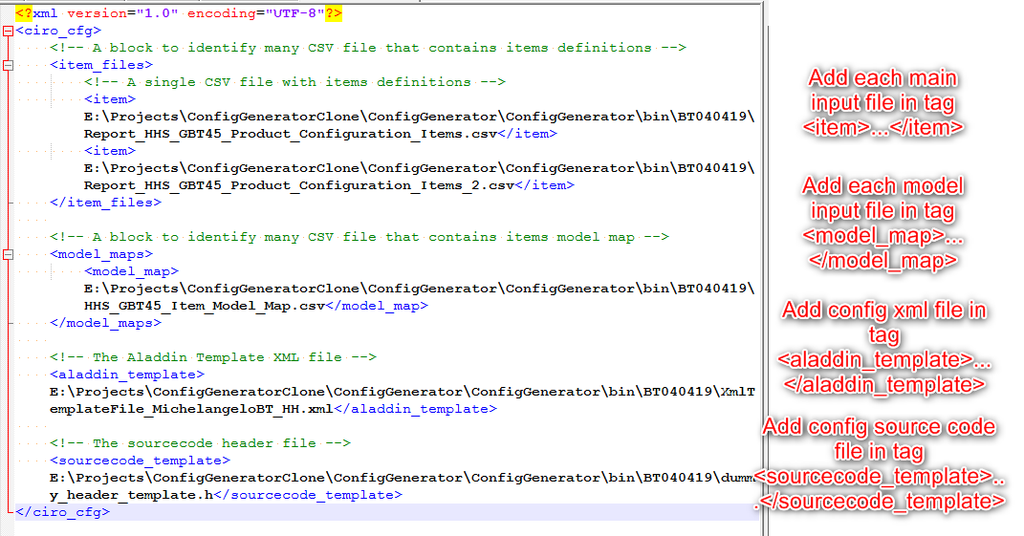
Parameter file
USA
www.datalogic.com
Copyright Datalogic 2017 – Confidential & Proprietary Information

Slide 6
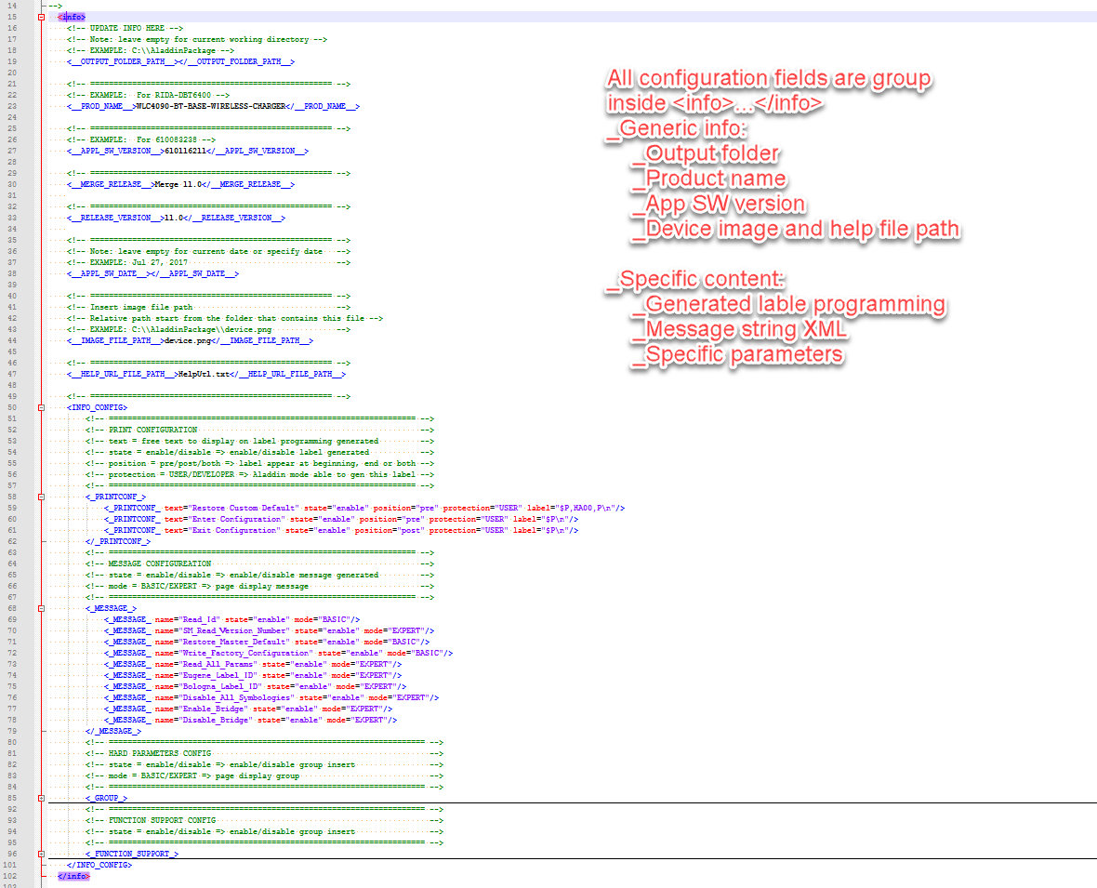
Config xml file
USA
www.datalogic.com
Copyright Datalogic 2017 – Confidential & Proprietary Information

Slide 7
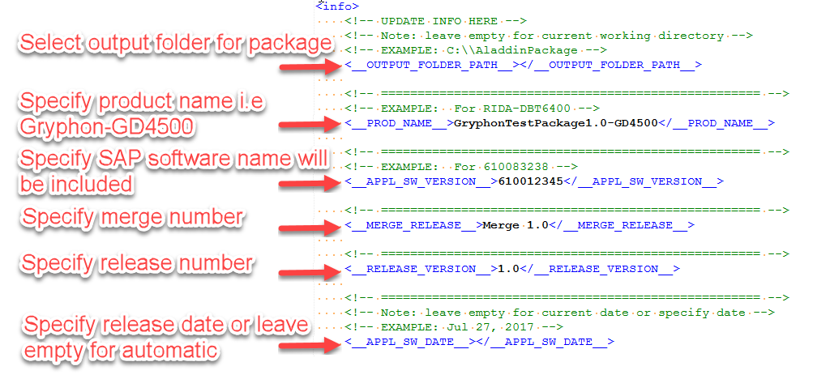
Config xml file
Config generic info
USA
www.datalogic.com
Copyright Datalogic 2017 – Confidential & Proprietary Information

Slide 8
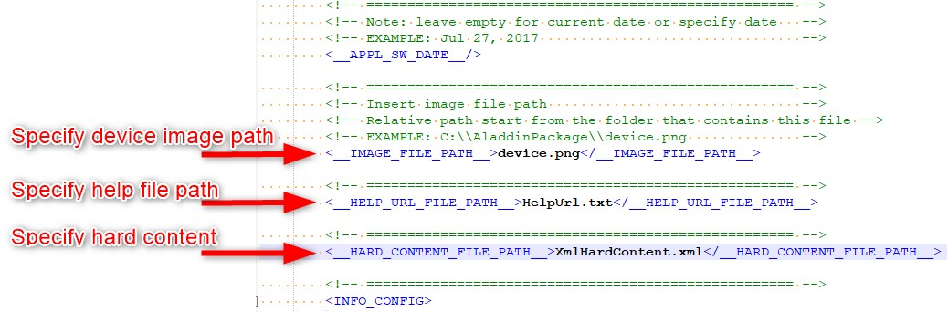
Config xml file
Config generic info
USA
www.datalogic.com
Copyright Datalogic 2017 – Confidential & Proprietary Information

Slide 9
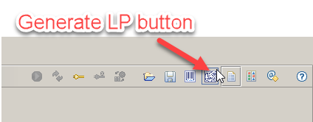
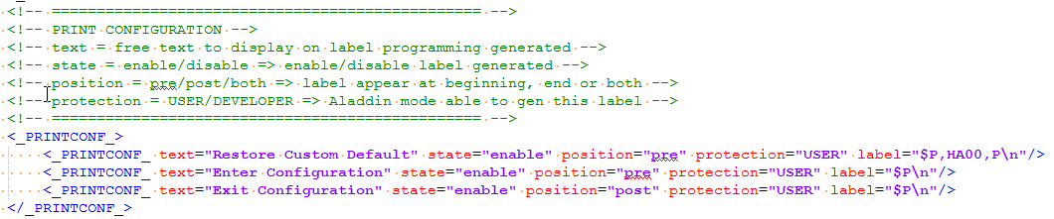
Config xml file
Config specific content could be printed on label programming
USA
www.datalogic.com
Copyright Datalogic 2017 – Confidential & Proprietary Information

Slide 10
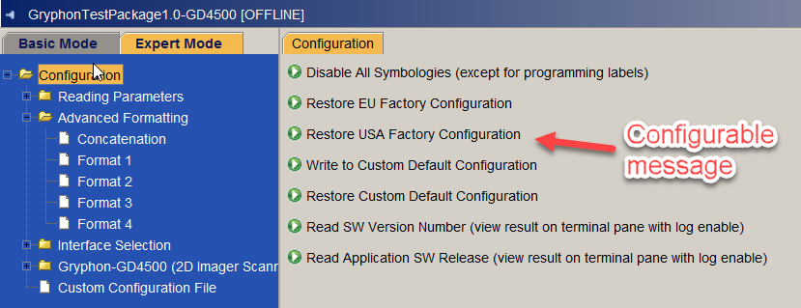
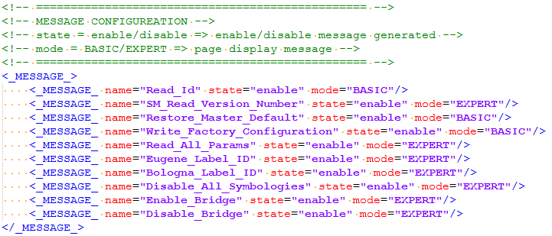
Config xml file
Config specific message could be displayed on Aladdin
USA
www.datalogic.com
Copyright Datalogic 2017 – Confidential & Proprietary Information

Slide 11
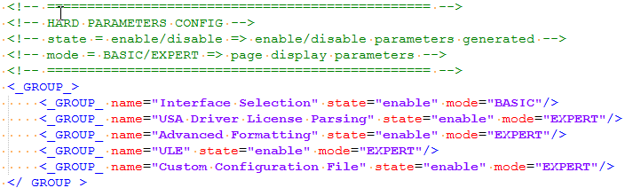
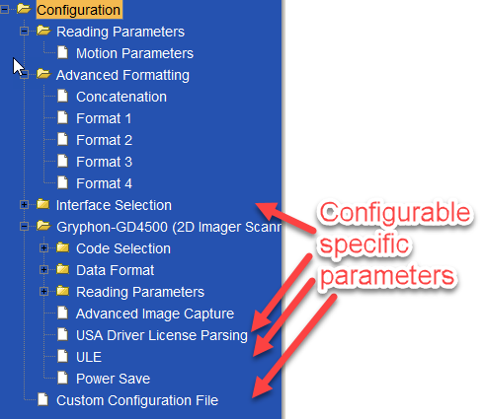
Config xml file
Config specific parameters could be displayed on Aladdin
USA
www.datalogic.com
Copyright Datalogic 2017 – Confidential & Proprietary Information

Slide 12
Config source code files
Config source code structure
Input settings
Include files
Exception enum items
Exception enum and structure items
Name space
Normal table
Special table
Normal delta table
Special delta table
CM variable and access function
Interface settings
Feature settings
Output settings
USA
www.datalogic.com
Copyright Datalogic 2017 – Confidential & Proprietary Information

Slide 13
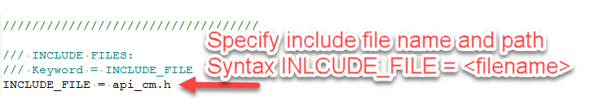
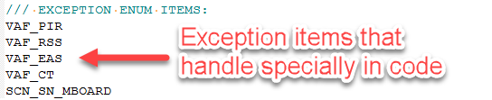
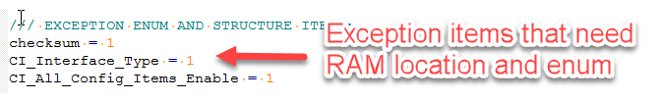
Config source code files
Input settings – Include files
Input settings – Exception enum items
Input settings – Exception enum and structure items
USA
www.datalogic.com
Copyright Datalogic 2017 – Confidential & Proprietary Information

Slide 14
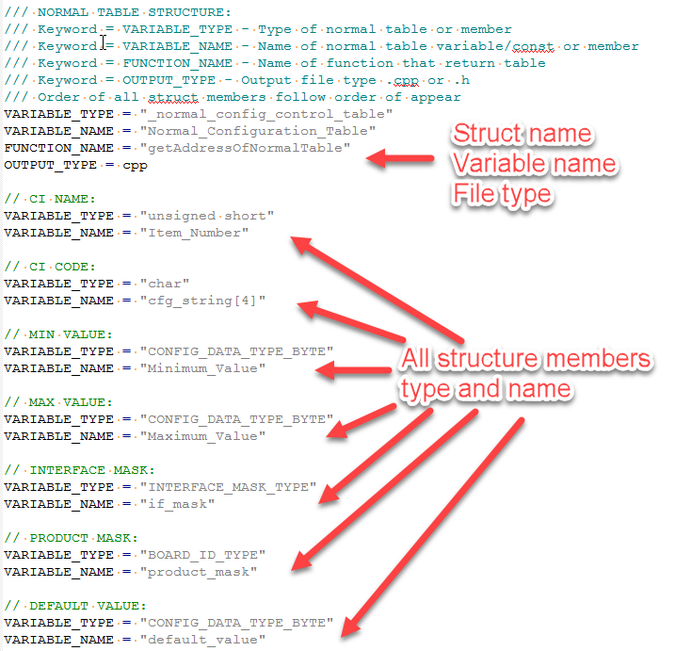
Config source code files
Input settings – Normal table
www.datalogic.com
Copyright Datalogic 2017 – Confidential & Proprietary Information

Slide 15
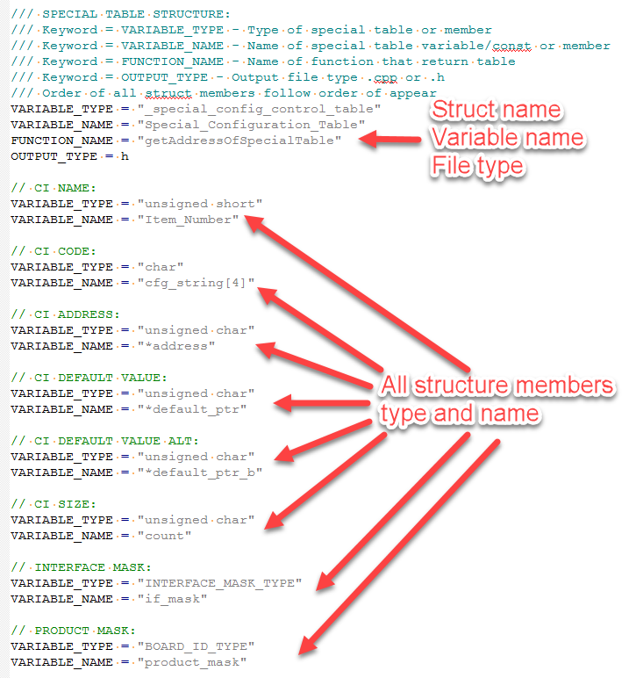
Config source code files
Input settings – special table
www.datalogic.com
Copyright Datalogic 2017 – Confidential & Proprietary Information

Slide 16
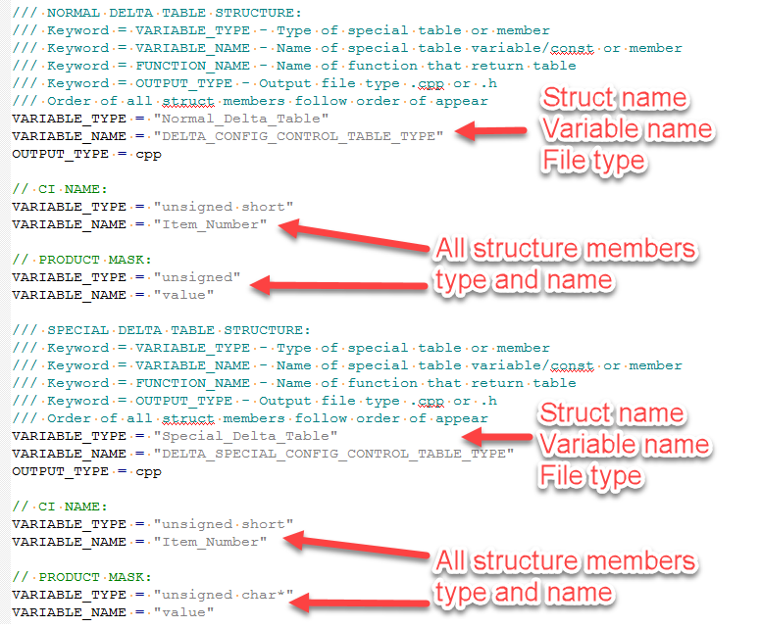
Config source code files
Input settings – delta table
www.datalogic.com
Copyright Datalogic 2017 – Confidential & Proprietary Information

Slide 17
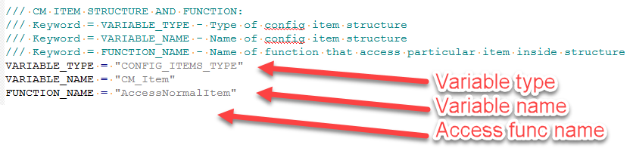
Config source code files
Input settings – CM variable and access function
www.datalogic.com
Copyright Datalogic 2017 – Confidential & Proprietary Information

Slide 18
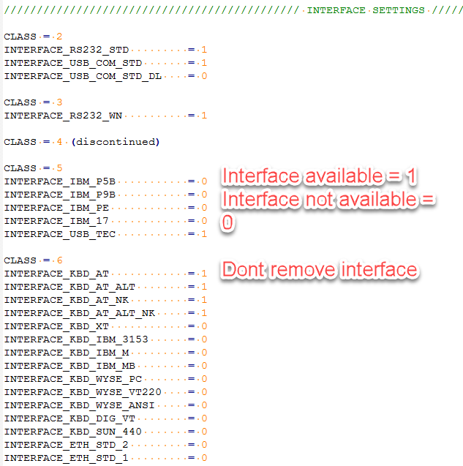
Config source code files
Interface settings
www.datalogic.com
Copyright Datalogic 2017 – Confidential & Proprietary Information

Slide 19
Config source code files
Feature settings
Output settings
www.datalogic.com
Copyright Datalogic 2017 – Confidential & Proprietary Information

Slide 20
Understand log message
There are following types of issue
Missing information
Incorrect data format
Duplicate information
Missing information
Record message: “Missing mandatory information”
Possible columns specified in record include:
Mandatory information
Configuration Item
CI_TagName
CI_ValueOption
All mandatory keywords
CI_Master_Default_Bologna
CI_Master_Default_Eugene
CI_ValueSizeBytes
CI_UserVisibility
Option information (only required if CI_UserVisibility is PUBLIC)
CI_AladdinVisibility
CI_AladdinPagePosition
CI_SupportedModels
CI_AladdinRule
www.datalogic.com
Copyright Datalogic 2017 – Confidential & Proprietary Information

Slide 21
Understand log message
Incorrect data format
Record message: "Information is incorrect format“
Possible columns is specified in record include:
Configuration Item is not 4 characters
CI_ValueOption has max value is 0
CI_ValueOption (Custom) has size of member inconsistent with total size
Incorrect Hex value format
Record message: “Information is incorrect Hex format”
Possible columns is specified in record include:
CI_ValueOption
CI_Master_Default_Bologna
CI_Master_Default_Eugene
CI_InterfaceClass
Error: Value with 0x prefix but contain character outside 0-9, a-f, A-F
Warning: Value without 0x but contain character a-f, A-F
Incorrect Int value format
Record message: “Information is incorrect Decimal format”
Possible columns is specified in record include:
CI_ValueOption
CI_Master_Default_Bologna
CI_Master_Default_Eugene
CI_InterfaceClass
Error: Value without 0x prefix but contain character outside 0-9
www.datalogic.com
Copyright Datalogic 2017 – Confidential & Proprietary Information

Slide 22
Understand log message
Duplicate information
Record message: "Duplicate data “
Possible columns is specified in record include:
Configuration Item: There are 2 or more row has same Configuration item
CI_AladdinPagePosition: There are 2 or more category but place at same position
CI_TagName: Tag name in csv file duplicated with predefined listed or internal Aladdin list
Aladdin will display the item at
Location specified in CI_AladdinPagePosition
Name specified in CI_TagUserName
Aladdin allow display
Same config item instances in many positions (i.e USSE) This item value will be same at every location
Different config item instances in many positions. Item values are not the same at every location. These items usually depend to interface
Aladdin would cause issue if
Different config item’s intances in same position. Item values are not the same at same location.
www.datalogic.com
Copyright Datalogic 2017 – Confidential & Proprietary Information

Slide 23
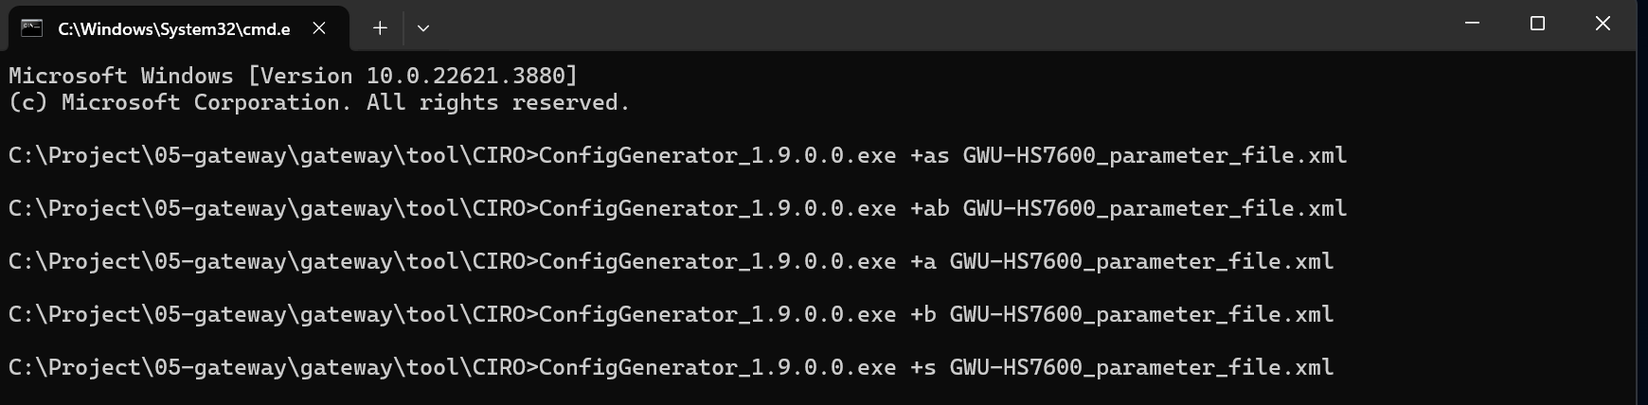
Run in command line
Syntax to run CIRO in console mode
Note: “+as” or “ab” or “+a” or “+b” or “+s” is compulsory when running in the console mode
“+as”: Generate the Aladdin package and source code files.
“+ab”: Generate the Aladdin package and bin files.
“+a”: Generate the Aladdin package.
“+b”: Generate bin files.
“+s”: Generate source code files.
www.datalogic.com
Copyright Datalogic 2017 – Confidential & Proprietary Information

Slide 24
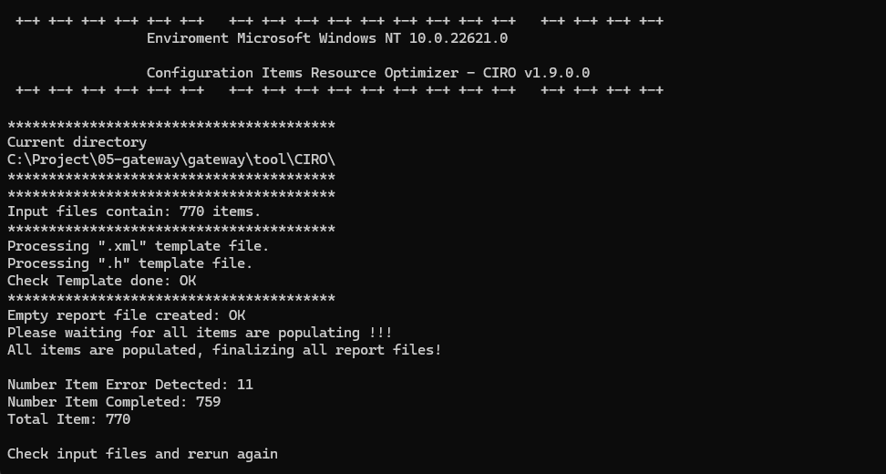
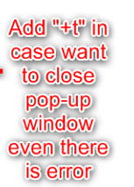
Run in command line
www.datalogic.com
Copyright Datalogic 2017 – Confidential & Proprietary Information

Slide 25
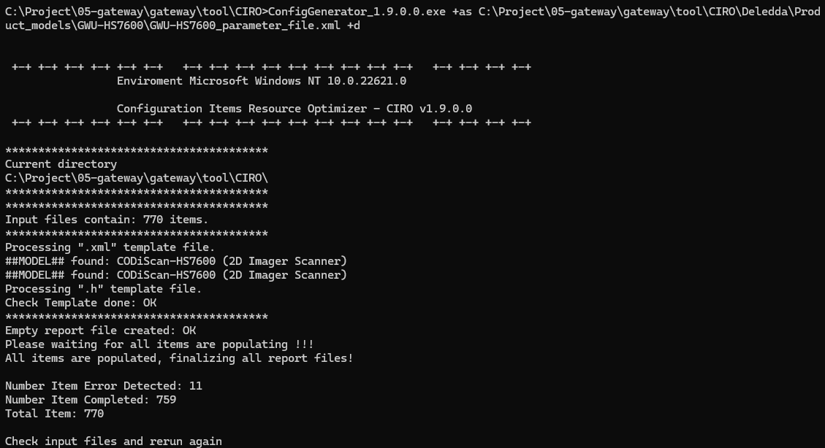

Run in command line
www.datalogic.com
Copyright Datalogic 2017 – Confidential & Proprietary Information

Slide 26
Thank you
Datalogic S.p.A.
Via Candini, 2
40012 Lippo di Calderara di Reno
Bologna – Italy
Tel. +39 051 3147011
Fax +39 051 3147205
E-mail corporate@datalogic.com
www.datalogic.com
Copyright Datalogic 2017 – Confidential & Proprietary Information

